Slide 1
Software Architecture -
RPC and Representational State Transfer (REST)
Phil Pfeiffer
February 2013
Includes updated notes on REST UI design from Jeremiah Dangler presentation, Dec. 2012

Slide 2
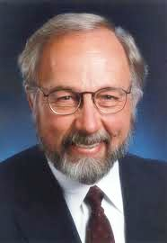
Focus on Web: Rationale
The network is the computer.
John Gage,
Sun Microsystems, 1985
Importance of networking in computing, commerce
Importance of web applications in
networked computing

Slide 3
Factors Complicating Web Applications
Sending requests
▪ Web apps must transfer data from client to server with request
▪ Transfer particularly severe in presence of pointers (e.g., C++),
or references to large blocks of data (e.g., Java)
Reliability of request-response cycle
▪ Web transmissions can fail, due to network and server errors
▪ Failures must be accounted for to ensure integrity of
request-response-based transactions
Receiving responses
▪ Web transmissions incur network delays
▪ Delays materially affect application acceptability
Waldo, Wyant, Wollrath, Kendall, A Note on Distributed Computing, SMLI TR-94-29, Nov. 1994
(cf. http://citeseerx.ist.psu.edu/viewdoc/summary?doi=10.1.1.41.7628)

Slide 4
Web Performance Requirements
Pages must load within 2 seconds
▪ Source: 2009 survey of 1,048 online shoppers
▪ for Akamai, by Forrester Consulting
▪ 52% of shoppers: loading speed important for loyalty
▪ 47% of shoppers expect pages in 2 seconds or less
▪ 40% of shoppers will wait no more than 3 seconds
▪ 79% of shoppers less likely to return after
dissatisfying site visit
Checkout must be fast
▪ Source: same survey
http://www.akamai.com/html/about/press/releases/2009/press_091409.html;

Slide 5
Managing Web-Related Complications
Restricting request-response coupling
▪ Restricting use of reference data in requests
Allowing for request-response cycle failure
▪ Imposing timeouts on requests
▪ Using idempotent requests
▪ Executing response once has same effect as executing N times
▪ Tagging non-idempotent requests with unique IDs
▪ To avoid request re-execution
▪ Tagging items in request streams with IDs
▪ To avoid out-of-order execution
Compensating for network overhead
▪ Cacheing data at server (to avoid resend)
▪ Cacheing of results between server, client (to reduce latency)
▪ Supporting concurrent requests (to improve throughput)

Slide 6

Web Software Architecture and RPC
RPC = remote procedure call
▪ First idea for high-level mechanism
for networked communication
▪ Due to Bruce Nelson (1952-1999)
Idea
▪ Support access to remote services by blurring distinction between local, remote computers
▪ Goal: make distributed codes as easy to write as ordinary codes
▪ In practice: need to account for complications noted in last slide
▪ Basis of SOAP-based SOA's, various component standards
(e.g., CORBA, EJB)

Slide 7


Web Software Architecture and REST
REST = REpresentational State Transfer
Due to Roy Fleming
▪ An author of HTTP 1.0, 1.1
▪ From 2000 dissertation on implementing hypermedia
▪ Invented by sociologist Ted Nelson (1963)
▪ Realized as World-Wide Web (early 1990s)
Issues
▪ Keep applications maintainable
▪ Use small, composable components
to create complex applications
▪ Keep applications evolvable
▪ Limit rippling of changes in one component
to other components
▪ Allow applications to scale gracefully
▪ Allow linear increase in resources
to yield linear increase in throughput

Slide 8
REST Elements - Tiered Client-Server
▪ Client-server decouples UI and data storage
▪ Allows for cross-platform UI
▪ Tiered client-server allows for separation of concerns
▪ Firewalls for security
▪ Front-end proxies for adapting legacy systems to Internet
▪ Cacheing proxies for improving application performance
▪ Need to flag non-cacheable data, manage stale data
Issues
▪ Extra network traffic
▪ Loss of server control over application behavior

Slide 9
REST Elements - Stateless Servers
▪ Client stores all session data
▪ Each request must be totally self-contained
Rationale – simpler server-side architecture
▪ Server-side systems process requests independently
▪ Eliminates handshaking
▪ Improves parallelism
▪ Eases server recovery from partial network failure
▪ Eliminates need to reconstruct internal state at time of failure to re-process a failed request
▪ Improves server speed and maintainability
▪ Resource usage limited to individual requests
▪ Resources freed immediately at completion of request

Slide 10
REST Elements – Messages
Consists of resource(s) + control data
Resource(s): two types
▪ Resource identifiers (e.g., URL's, URN's)
▪ Actual content (a.k.a. representations)
▪ Data - e.g., HTML document, JPG image
▪ Meta-data - (name, value) pairs, where
▪ name specified by a meta-data standard (e.g., encoding)
▪ value is the metadata proper (e.g., MIME)
▪ Meta-meta-data - e.g., naming meta-data standard(s) in use
Control data
▪ Defines message purpose: e.g., nature of request or response
▪ Parameterizes requests
▪ Supports behavior overrides for connecting elements: e.g., cacheing

Slide 11
REST Elements - Components
Origin servers - e.g., Apache, IIS
Gateways - e.g., Squid
Proxies
User agents - e.g., Internet Explorer, spiders
REST Elements - Connector Types
Clients, servers, caches, (DNS) resolvers, tunnels
▪ Tunnels modeled because some components (i.e., proxies) dynamically switch behavior

Slide 12
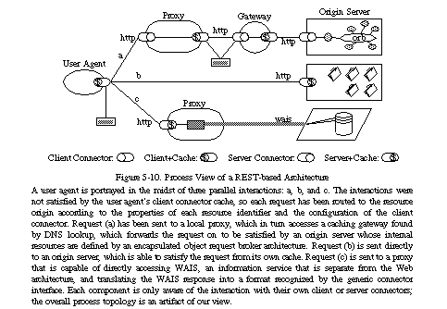
REST Architecture View (Fielding)

Slide 13
REST UI Design
Six-part process
Identify classes of users
Identify resources
Identify supported requests, on per-user basis
Develop abstract protocol for service request
Identify format(s) for realizing protocol in different standards
Publish URI for accessing interface

Slide 14
Identify Classes of Users
Assumes different users have different levels of privilege
Assumes additional request for
  Authenticating user to server
  Returning time-limited cookie from server to client system
Allows for exposing different operations to different classes of users
Mechanics not detailed here

Slide 15
Identify Resources
Use nouns
  Plural for collections
  Singular for individuals
Resources will have a URI
Example
Resource | Collection URI | Element URI
course(s) | http://foo.bar/courses | http://foo.bar/course
student(s) | http://foo.bar/students | http://foo.bar/student
assignment(s) | http://foo.bar/assignments | http://foo.bar/assignment
grade(s) | http://foo.bar/grades | http://foo.bar/grade

Slide 16
Identify Supported Requests: Resources
Use HTTP verbs for per-resource CRUD operations
  GET – retrieving a resource along with the metadata
  PUT – creating a new resource
  POST – updating an existing resource
  DELETE – deleting a resource
  HEAD – only retrieve the meta data for a resource
  OPTION – retrieve what actions are available for a resource
Determine actions on per-resource, per-user-class basis
 | GET | PUT | POST | DELETE | OPTION
/course | Yes | Yes | Yes | Yes | Yes
/courses | Yes | No | No | No | Yes
/student | Yes | Yes | Yes | Yes | Yes
/students | Yes | No | No | No | Yes

Slide 17
Identify Supported Requests: Other
Authenticating to server
Retrieving catalogue of available resources and per-resource requests

Slide 18
Abstract Protocol for Requests
Allow all transactions to be managed via hypermedia,
with single point of communication
  Maximizes service's maintainability
    Limits number of URLs to support
    Simplifies task of evolving services
Example:
  <!-- add course 132 to catalogue -->
  put http://foo.bar/course?id=132&rubric=CSCI&number=1250
  <!-- retrieve class list for course 132 -->
  get http://foo.bar/students?in_course=132
  <!-- retrieve assignments for course 132 -->
  get http://foo.bar/assignments?in_course=132
  <!-- delete course 132 from catalogue -->
  delete http://foo.bar/courses?id=132
Difficult in practice
  Most designs of RESTful APIs don't meet this requirement

Slide 19
Content Negotiation
Uses Accept, Accept-Language, Accept… headers
  Accept: text/html: 0.5, text/xml: 0.3, text/plain 0.1
  Accept-Language: English, Japanese …
HTTP Response Codes
  200 OK
  201 Created
  301 Moved
  403 Forbidden
  404 Not Found

Slide 20
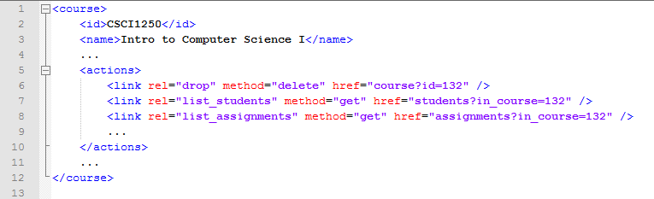
Realizing Protocol in Standard Formats
Example: XML-based catalogue of resources, operations

Slide 21
RPC vs. REST
Relative popularity
▪ RPC-based frameworks are in widespread use (SOAP, CORBA, EJB…)
▪ REST community has its share of
▪ implementations (cf. http://www.zdnet.com/blog/newton/rest- style-architecture-in-the-real-world/17)
▪ conferences (cf. http://www.ws-rest.org)
▪ blogs (cf. http://thisweekinrest.wordpress.com)
Debate between RPC (e.g., SOAP, CORBA) and REST has generated a lot of heat
The one key difference, I think:
▪ RPC directs requests to procedures/ APIs
▪ REST directs requests to resources
▪ Requests can be interpreted by intermediary hosts on network
▪ Allows for transparent layering of services along request route

